Slide 1

NON-UNIFORM DATA COLLECTION
Institute of Industrial Automation
and Software Engineering
Intermediate Report
Nikita Jhawar
3441310

Slide 2
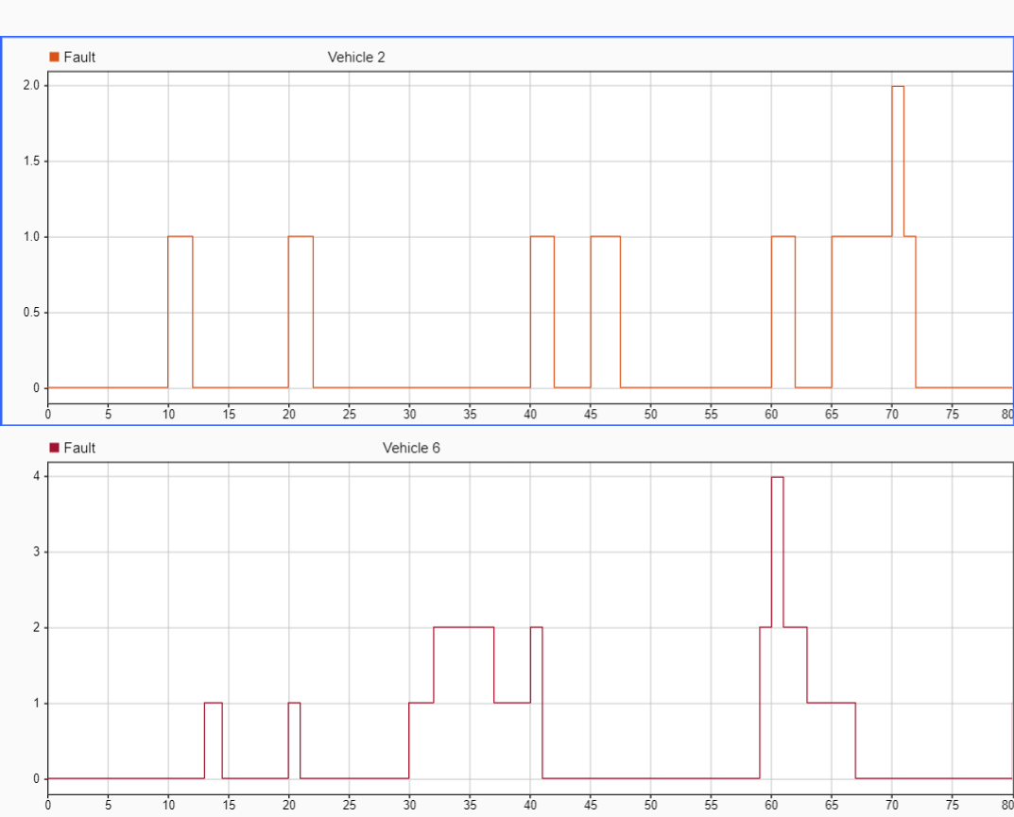
FAULT DATA SAMPLE

Slide 3
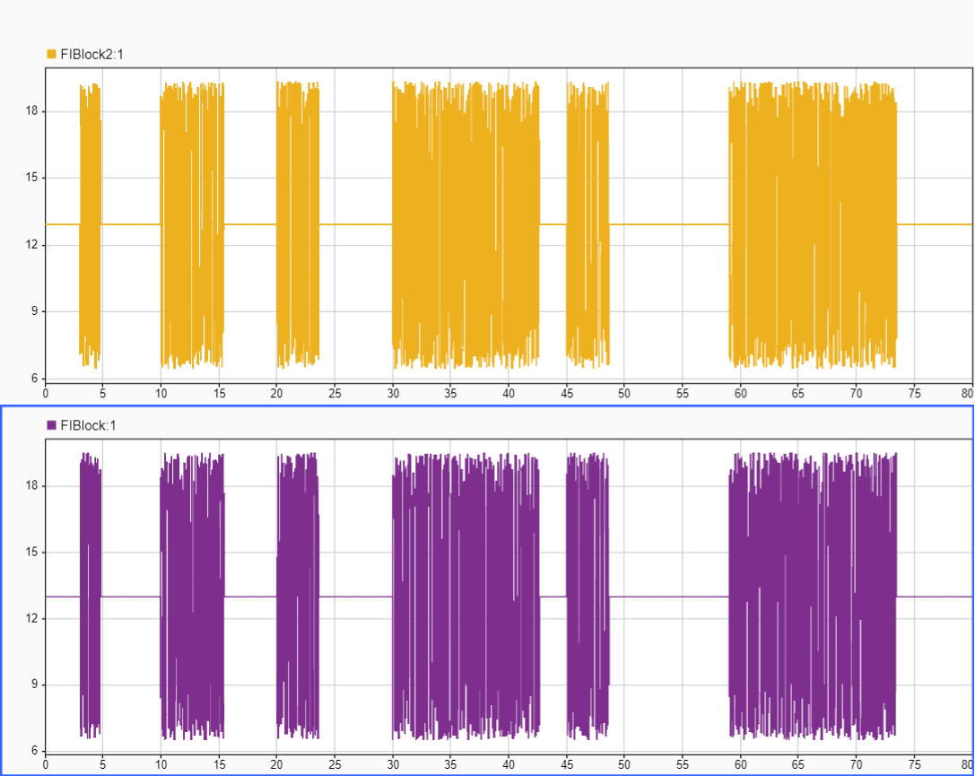
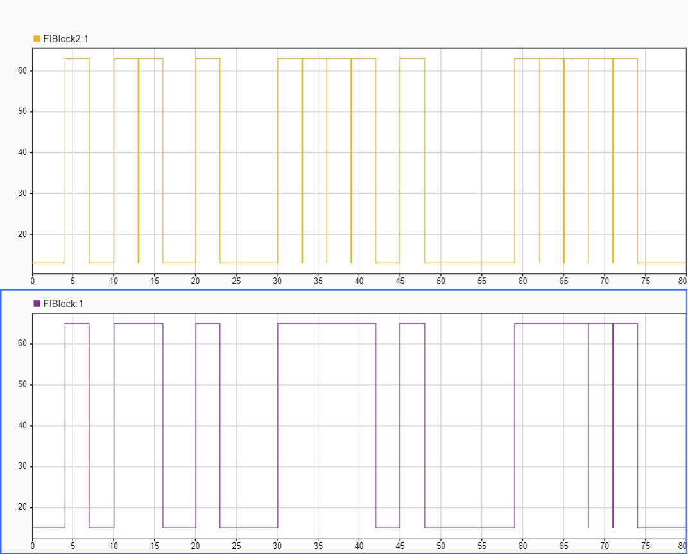
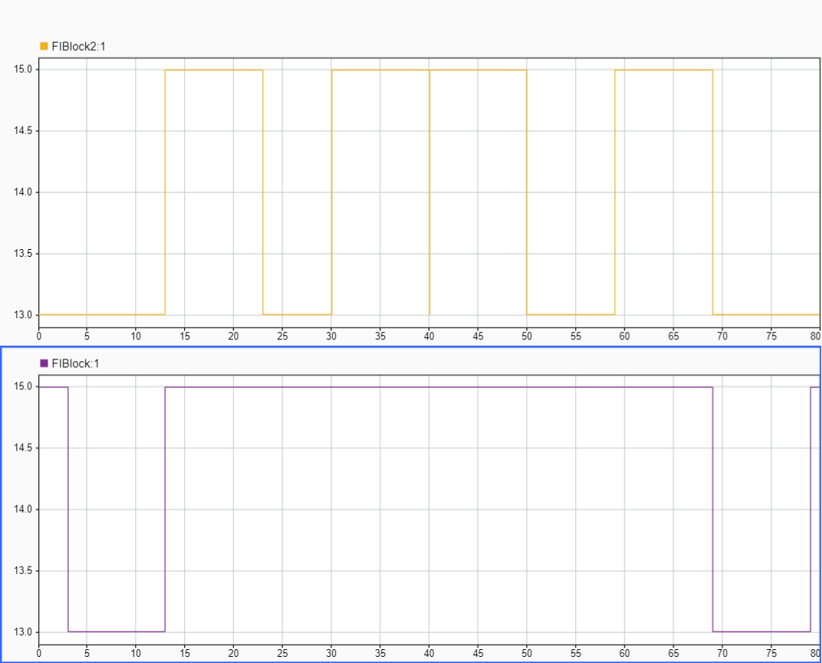
Faults
Noise
Offset
StuckAt

Slide 4
FAULT PARAMETERS
Fault Category | Fault Value | Fault Delay | Fault Duration
Bias/Offset | [50,70,90] | [0,1,2,3,4] | [0.6, 1.2, 1.8, 2.4, 3, 3.6, 4.2, 5]
StuckAt | Stuck to Last Value | [0,1,2,3,4] | [8,10,12]
Noise | [20,30,40,50,60] | [0,1,2,3,4] | [0.6, 1.2, 1.8, 2.4, 3, 3.6, 4.2, 5]
For each Driving Scenario, simulation for every fault category is run with randomly choosen values from the above table with fault being injected with a non uniform pulse at any point of time.

Slide 5
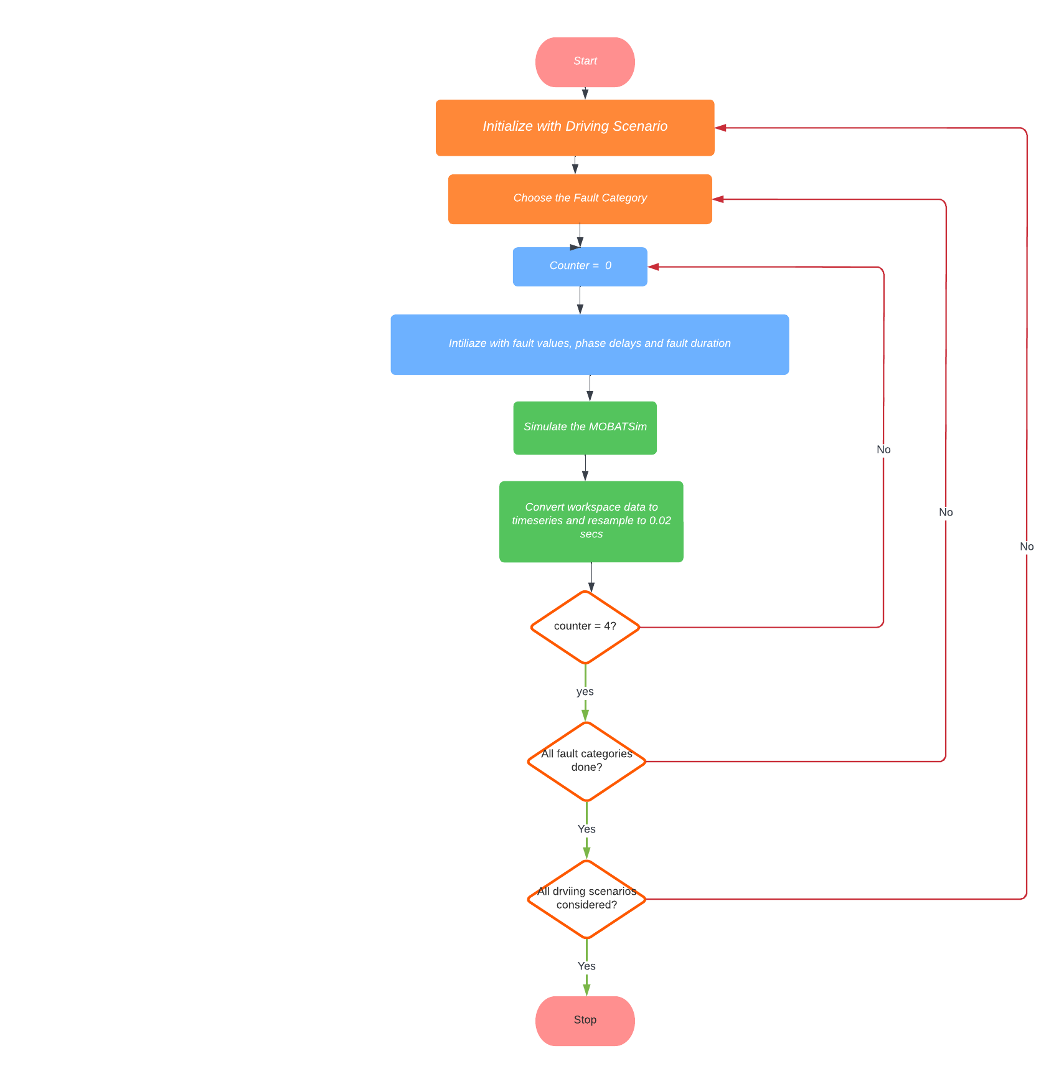
FLOW CHART

Slide 6
PLATOON CONTROL

Slide 7
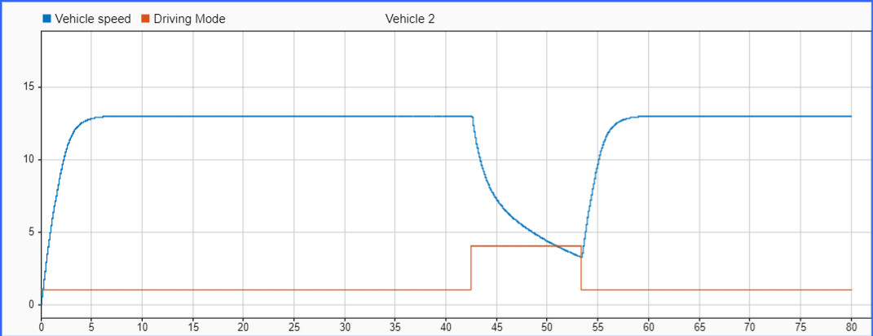
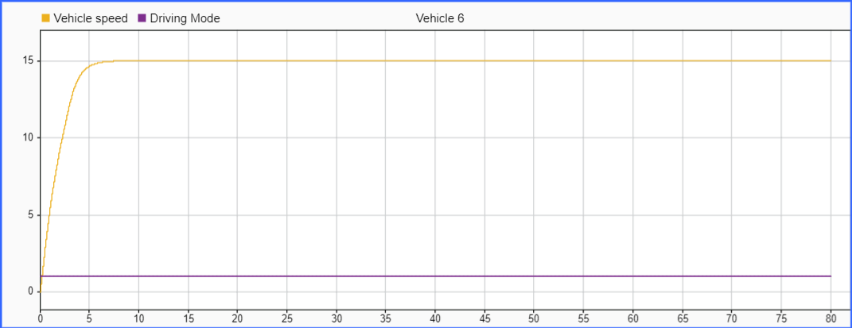
Fault Free(Platoon Control)
Vehicle 2
Vehicle 6

Slide 8
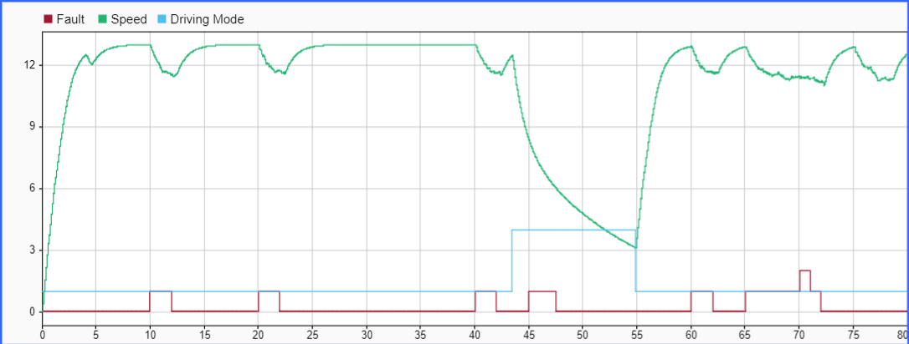
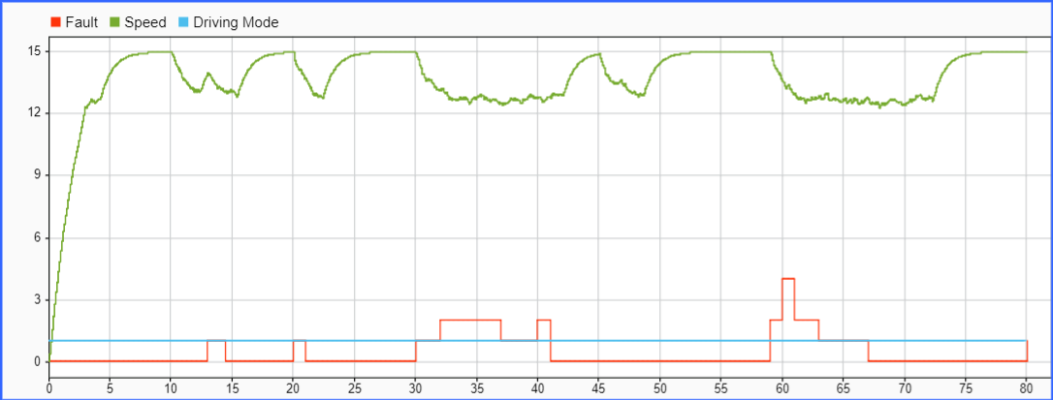
Noise (Platoon Control)
Vehicle 2
Vehicle 6

Slide 9
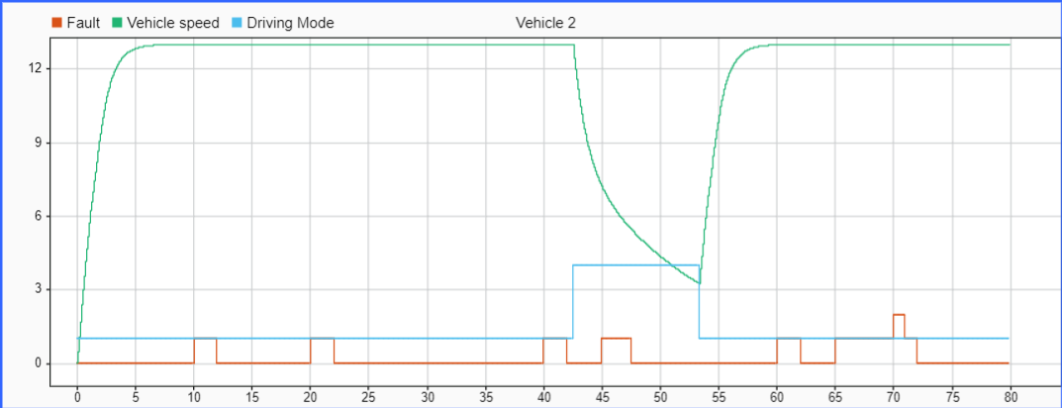
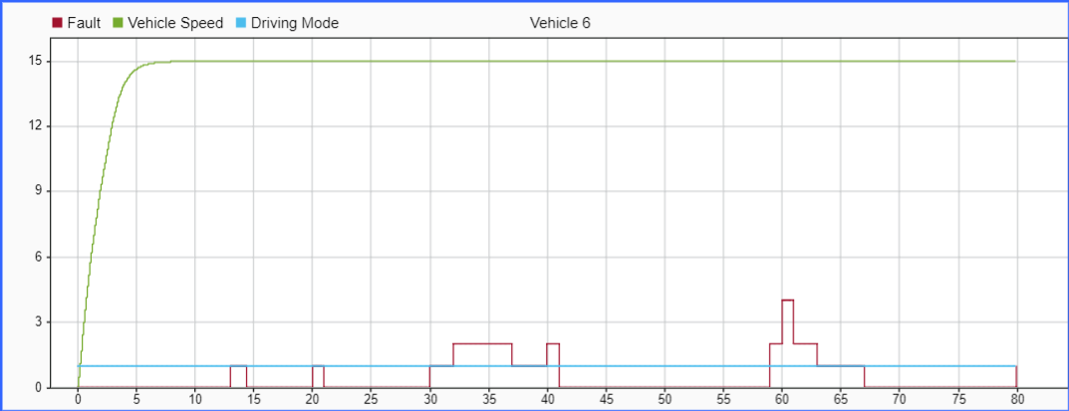
Offset (Platoon Control)
Vehicle 2
Vehicle 6

Slide 10
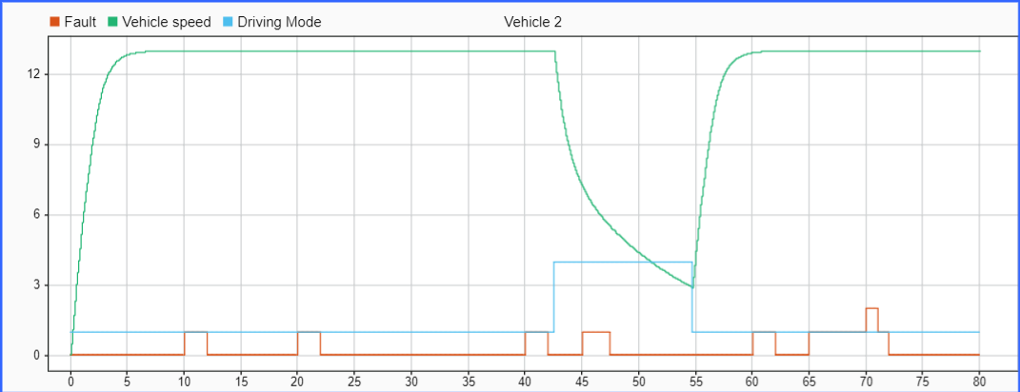
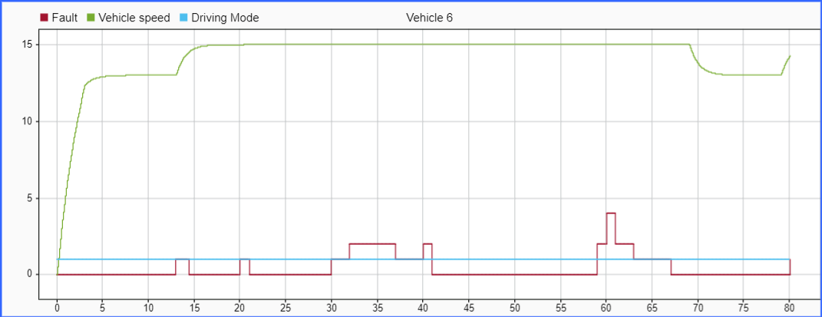
StuckAt (Platoon Control)
Vehicle 2
Vehicle 6

Slide 11
URBAN CITY TRAFFIC

Slide 12
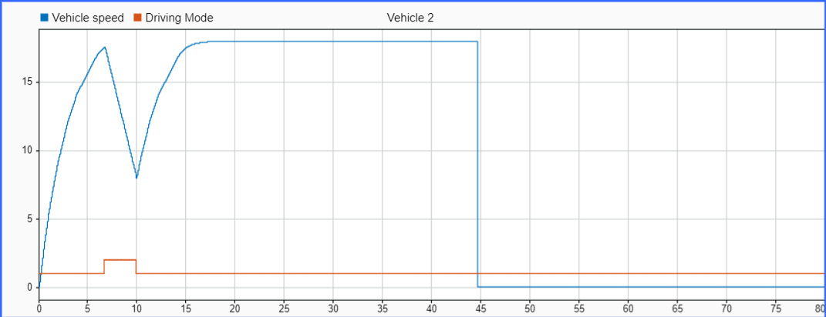
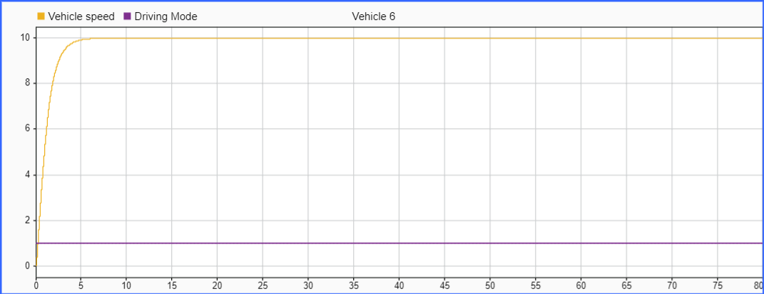
Fault Free(Urban City Traffic)
Vehicle 2
Vehicle 6

Slide 13
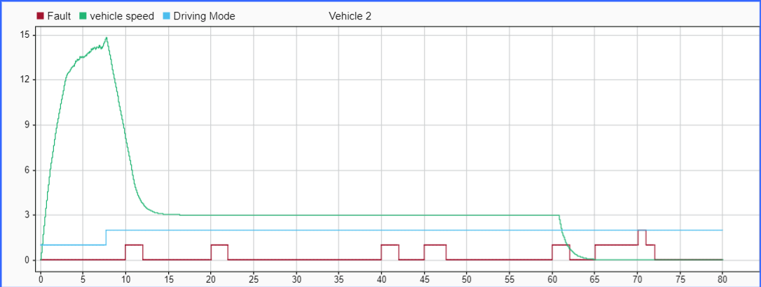
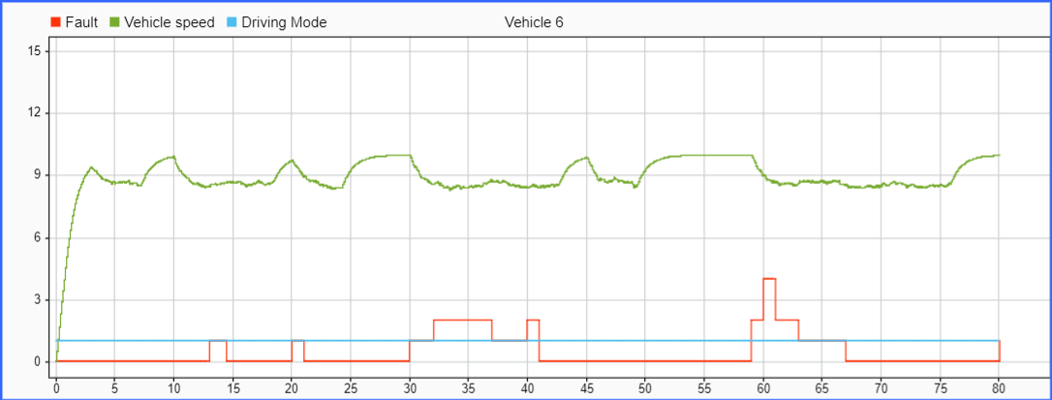
Noise (Urban City Traffic)
Vehicle 2
Vehicle 6

Slide 14
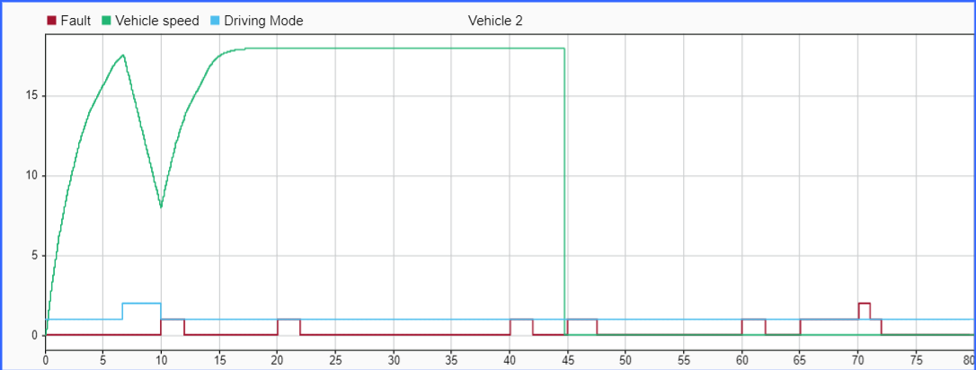
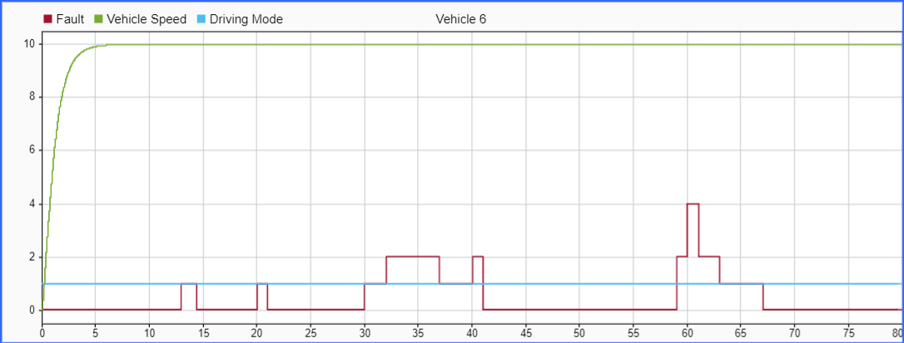
Offset (Urban City Traffic)
Vehicle 2
Vehicle 6

Slide 15
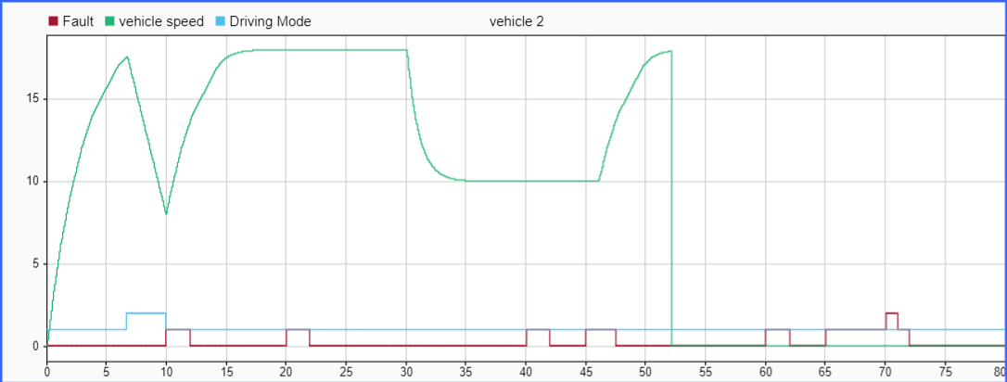
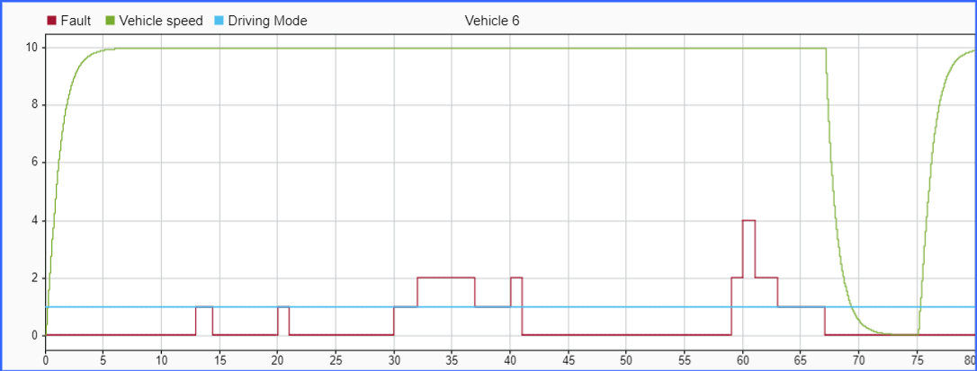
StuckAt (Urban City Traffic)
Vehicle 2
Vehicle 6

Slide 16
ROAD MERGE COLLISION

Slide 17
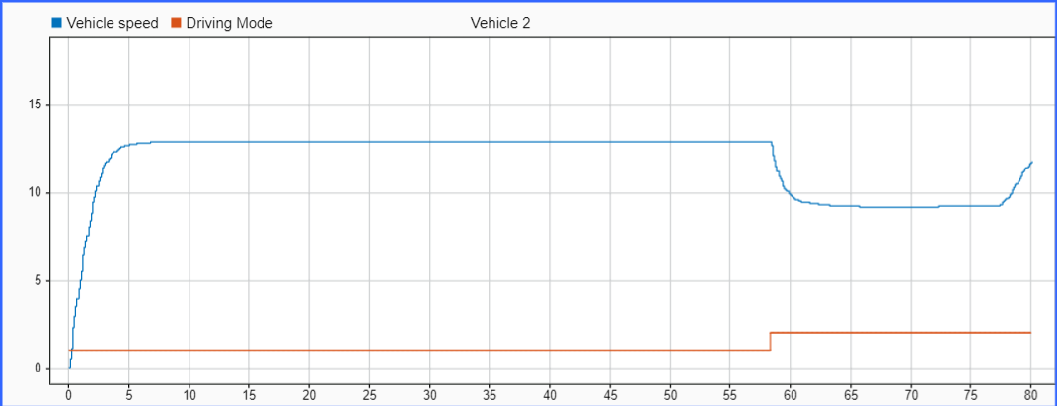
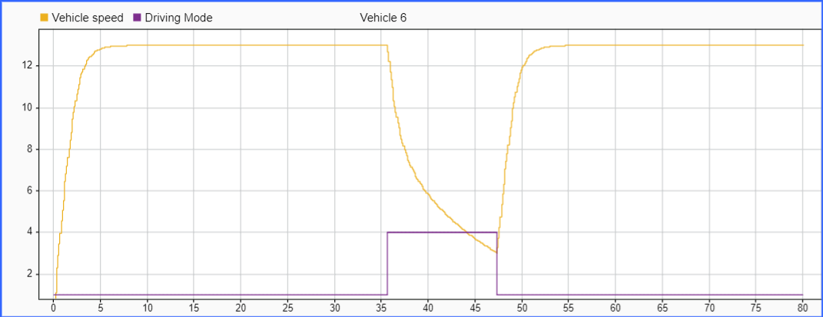
Fault Free(Road merge Collision)
Vehicle 2
Vehicle 6

Slide 18
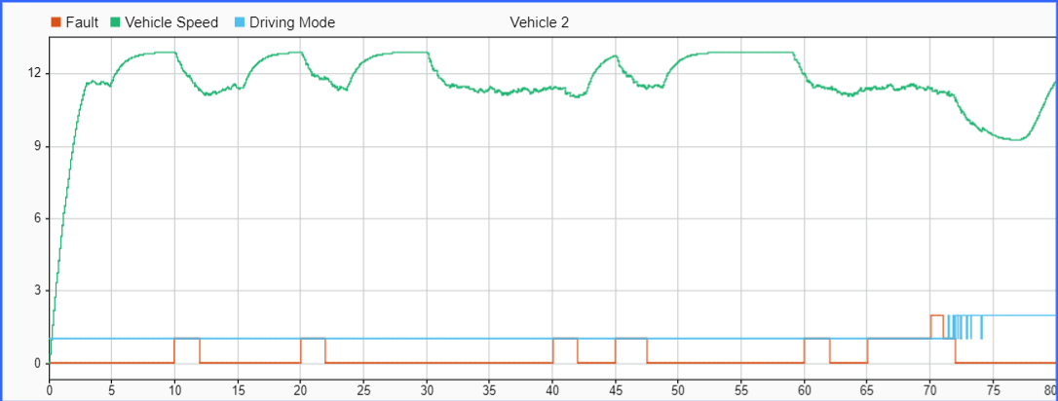
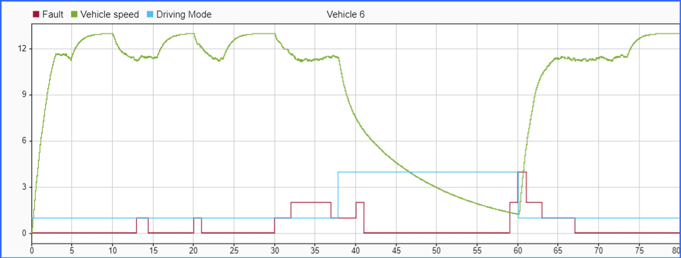
Noise(Road Merge Collision)
Vehicle 2
Vehicle 6

Slide 19
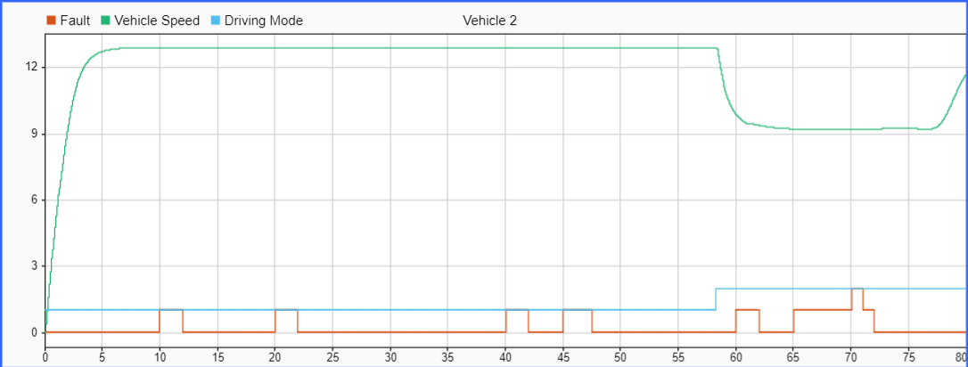
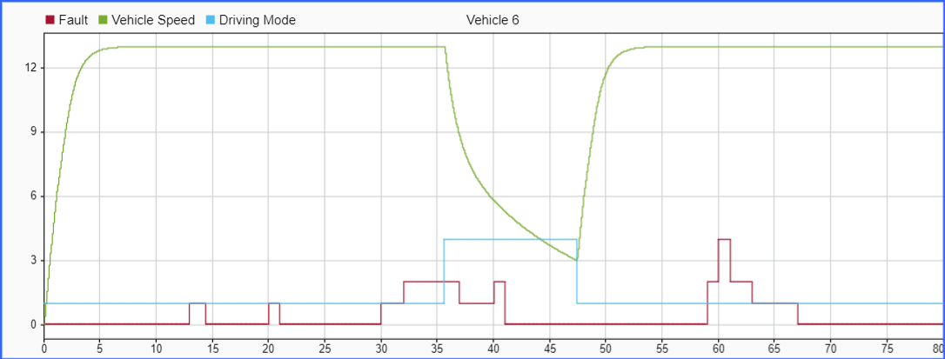
Offset(Road Merge Collision)
Vehicle 2
Vehicle 6

Slide 20
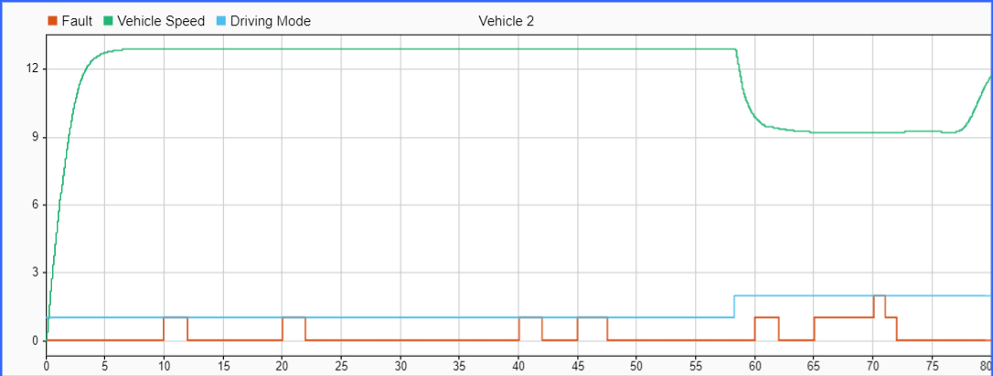
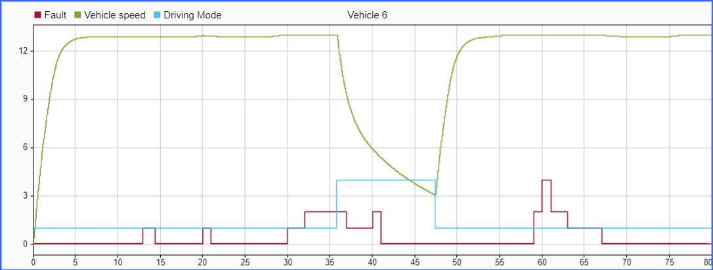
StuckAt(Road Merge Collision)
Vehicle 2
Vehicle 6

Slide 21
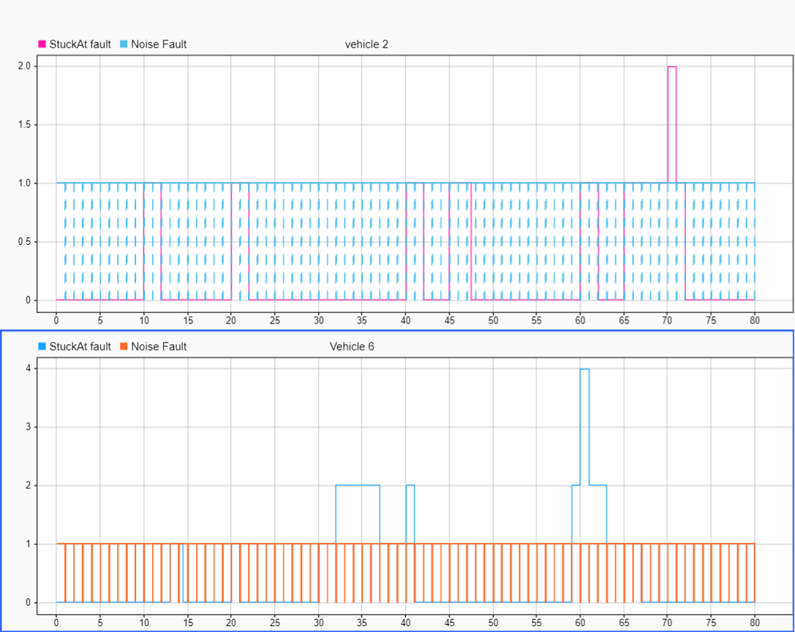
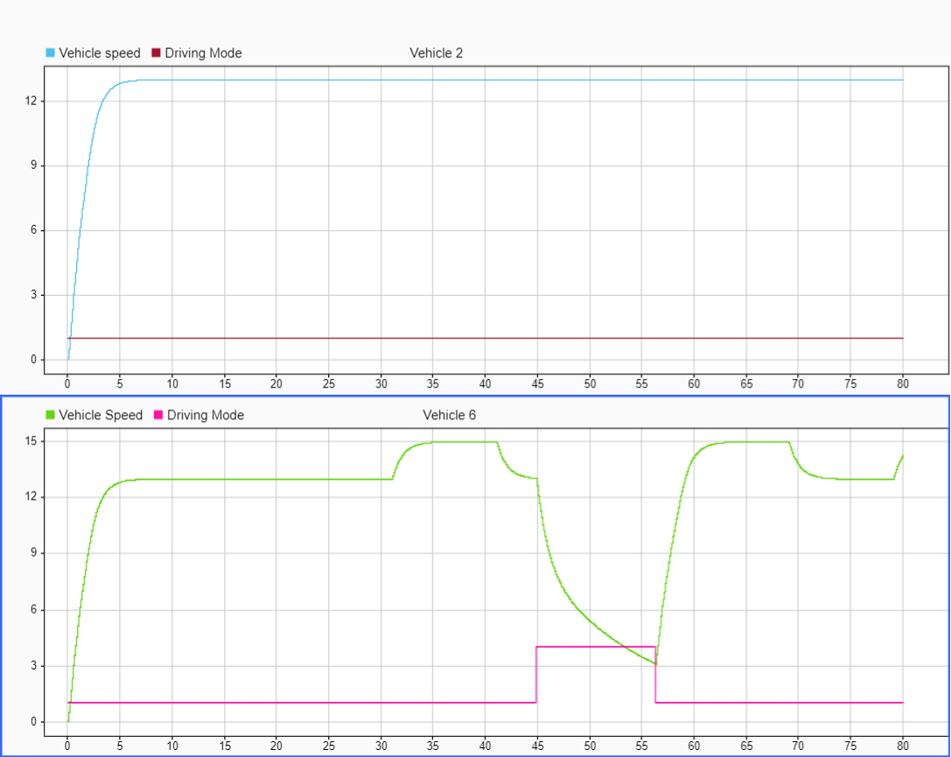
Noise and stuckAt Together

Slide 22
Conclusion
In case of Noise, speed graph shows good amount of distortion as soon a sthe fault is injected.
In case of StuckAt, speed graph of V2 does not show very minimal or neglectable distortions whereas vehicle 6 show some distortions (better than V2 but way less than noise)
In case of Offset, speed graph shows no distortions at all no matter how big fault value is chosen.

